Slide 1
The Yearly Teaching Quality Assurance Orientation Workshop (2023 -2024)
Teaching Quality Assurance
Dr. Baraa Al-Hashimi
TQA Director

Slide 2
Workshop Outline
General updates and regulations.
Continues Academic Development CAD.
Students feedback (2022 -2023).
Conclusions.
Q & A.

Slide 3
Workshop Objectives
Introduce the new lecturers to the basics of TQA.
Update senior faculties with the latest regulations.
Develop action plans for the Students feedback (2022 -2023).

Slide 4
General Updates & Regulations
1

Slide 5
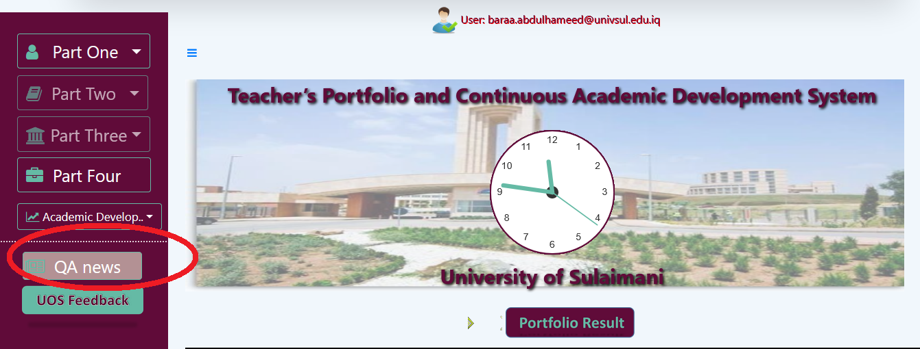
Official Quality Assurance News Update
Any activities, duties or updates regarding TQA will be posted in the news tab of the lecturers accounts.
Notes:
- Cant say I did not know.
- Check everyday.
No extensions
Official.
Transparency.

Slide 6
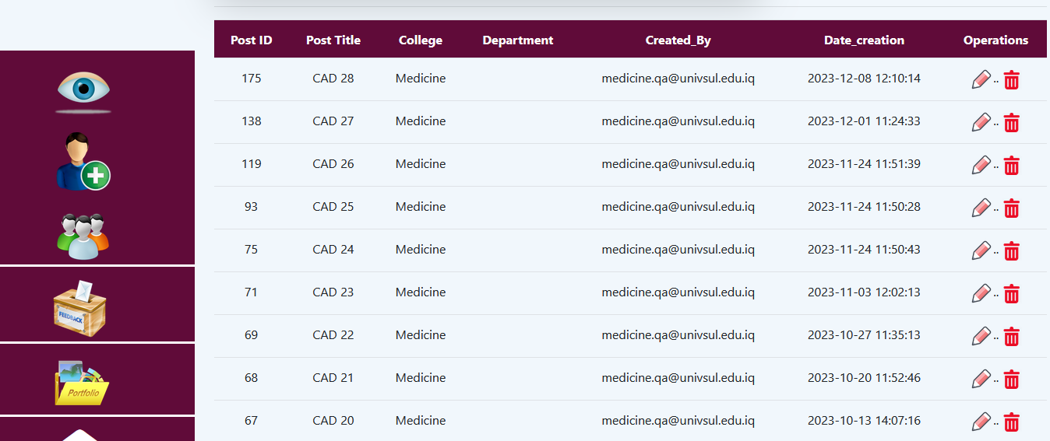
Official Quality Assurance News Update
Any activities, duties or updates regarding TQA will be posted in the news tab of the lecturers accounts.

Slide 7
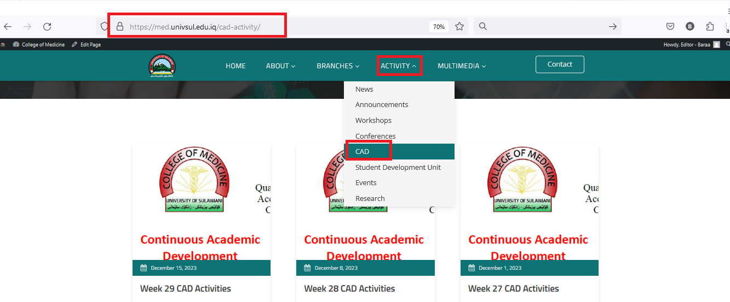

Slide 8
Requesting TQA Report for Promotion
In order to applying for scientific promotion its mandatory to pass all the TQA parameters as follows:
Notes:
The passing grade for all criteria is 5.

Slide 9
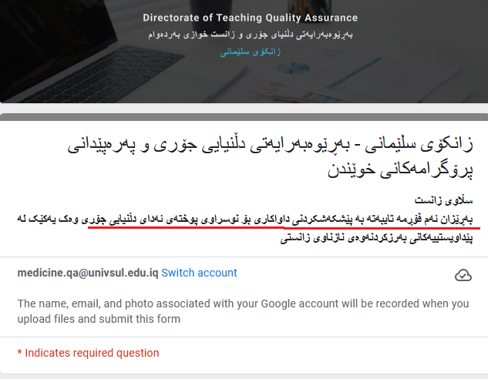
Requesting TQA Report for Promotion
Requesting the TQA reports is only available online using the form below (link in comment box):
Notes:
https://docs.google.com/forms/d/e/1FAIpQLScIGEojBLOTFlV9ZvvoZGrUdv_scd6HkSdG0xjF6RJ2D8kYFg/viewform
- Cannot be requested in person.

Slide 10
Requesting TQA Report for Promotion
It is possible to track the process and know when its ready to be collected with the following sheet :
Notes:
https://docs.google.com/spreadsheets/d/1r4N0uh_sWF0kZ4WNQk4-b81kDpa4_grakYpRFVABp4g/edit#gid=1358113591

Slide 11
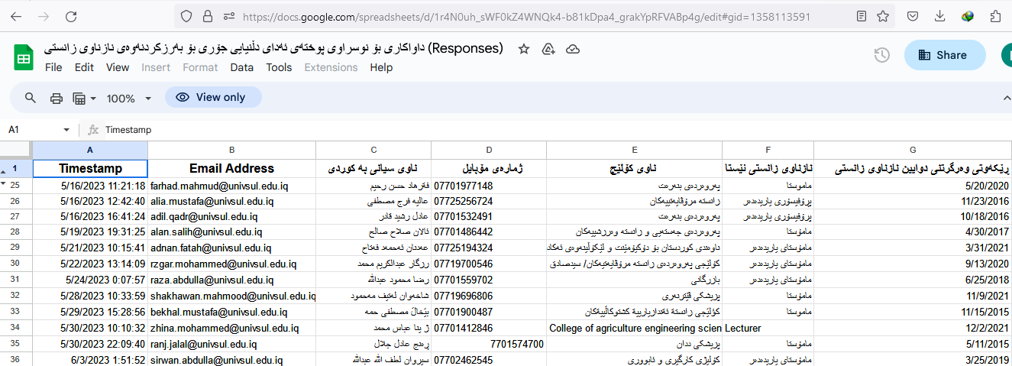
Requesting TQA Report for Promotion
Notes:
https://docs.google.com/spreadsheets/d/1r4N0uh_sWF0kZ4WNQk4-b81kDpa4_grakYpRFVABp4g/edit#gid=1358113591

Slide 12
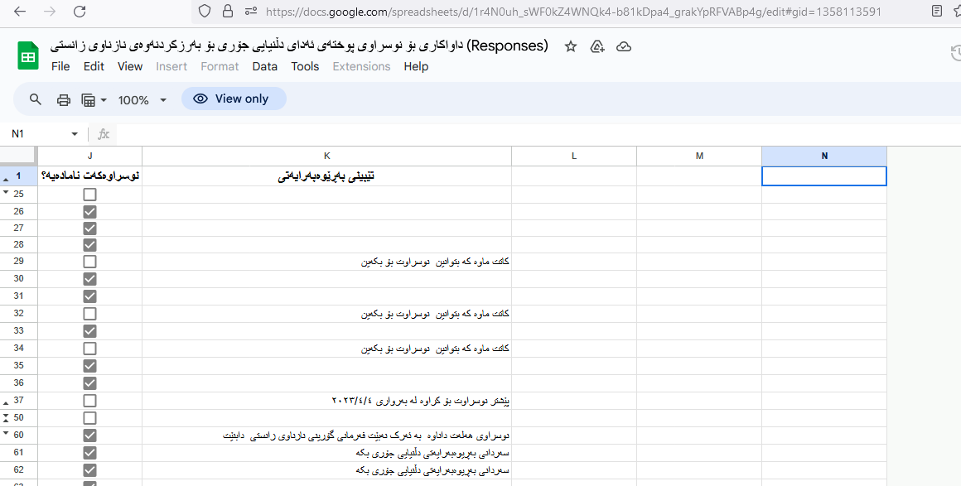
Requesting TQA Report for Promotion
Notes:
https://docs.google.com/spreadsheets/d/1r4N0uh_sWF0kZ4WNQk4-b81kDpa4_grakYpRFVABp4g/edit#gid=1358113591

Slide 13
Google Classrooms
All the lecturers and students should be invited to the corresponding classes and this is the duty of the module leader.
The coursebook (week 1) and all the studying materials must be uploaded to the classrooms.

Slide 14
Google Classrooms
All the students should have official Univsul e-mail to join the classes while avoiding any issues that could arise from joining by class codes.

Slide 15
Not Participating in the TQA System
Such act has severe consequences including:
Failure to acquire scientific promotion.
Suspension from teaching.
Negative impact on salary.
Tasking with administrative job in the presidency.

Slide 16
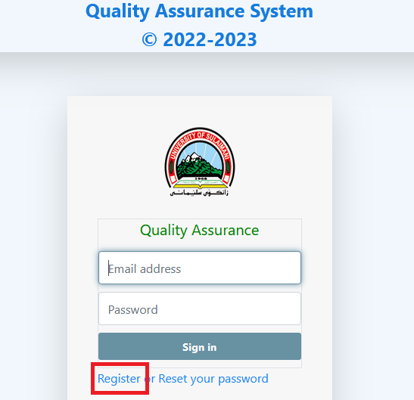

Slide 17
Continues Academic Development
2

Slide 18
CAD Points Requirements (Same)

Slide 19
Types of CAD Points (Same)

Slide 20
Publications Proof (Changed)
Active points for paper publication are now only approved when provided with “Acceptance letter” and not the final published paper.
Notes:
To avoid getting active points in 2 consecutive years.

Slide 21
PhD Student?
When filling the TQA forms, this questions is about yourself and not about if you supervise PhD students.
Notes:
It doubles the CAD score and its repeated every year.
Part time.

Slide 22
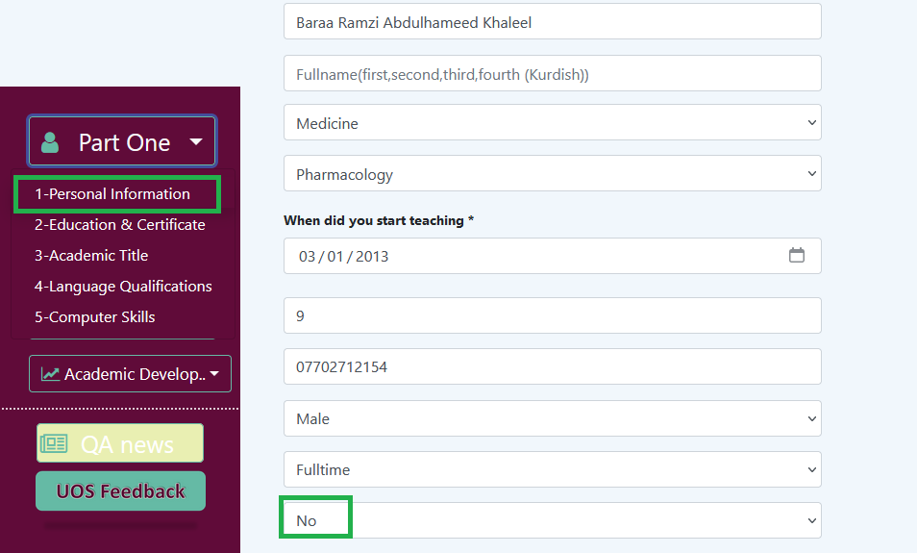

Slide 23
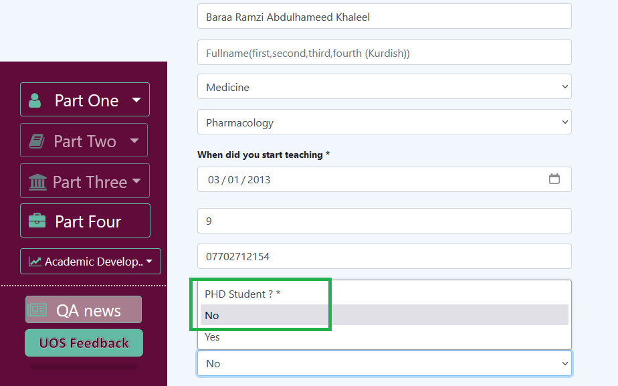

Slide 24
Reviewing Articles
Upload the confirmation of revision e-mail.

Slide 25
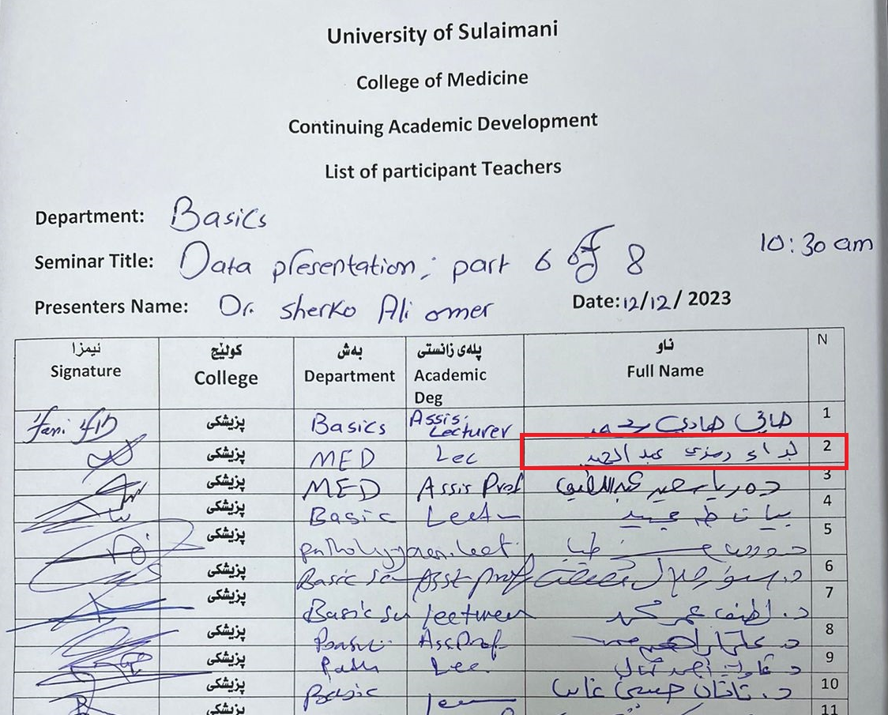

Slide 26
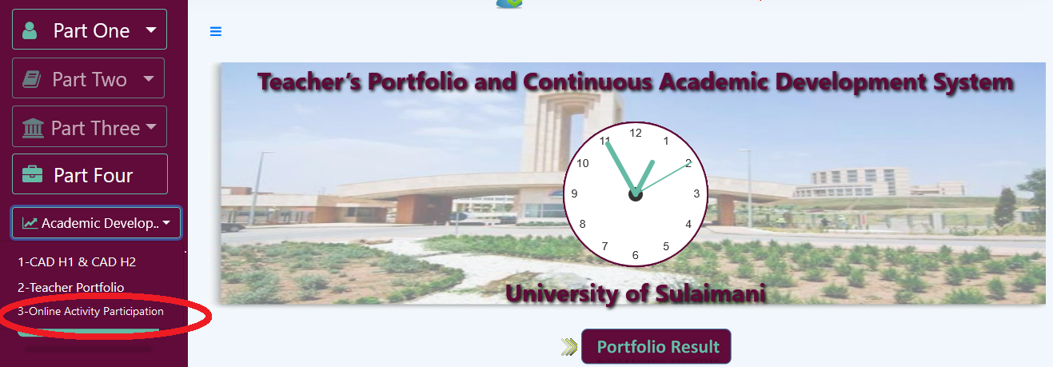
Online Activities
Restrictions have been applied to online activates and they currently require to be registered through TQA system.

Slide 27
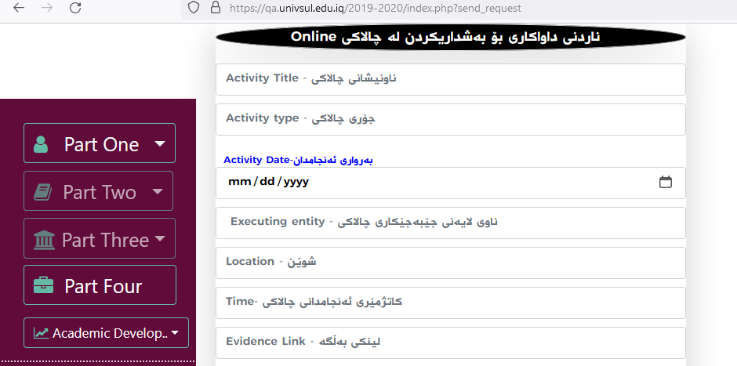
Online Activities
Restrictions have been applied to online activates and they currently requires to be registered through TQA system.
Notes:
Date .
Link for an official organization.

Slide 28
Online Activities
The activities should be registered at least 7 days before their presentation date and should be related to the sub-specialty of the attending lecturer.
The activities must be approved by the college TQA director then the University directorate.

Slide 29
Focal points
Filling Online CAD forms.
Oversee activities (e.g. Timing, feedback).
Future, using QR code.

Slide 30
Students Feedback 2022-2023
3

Slide 31
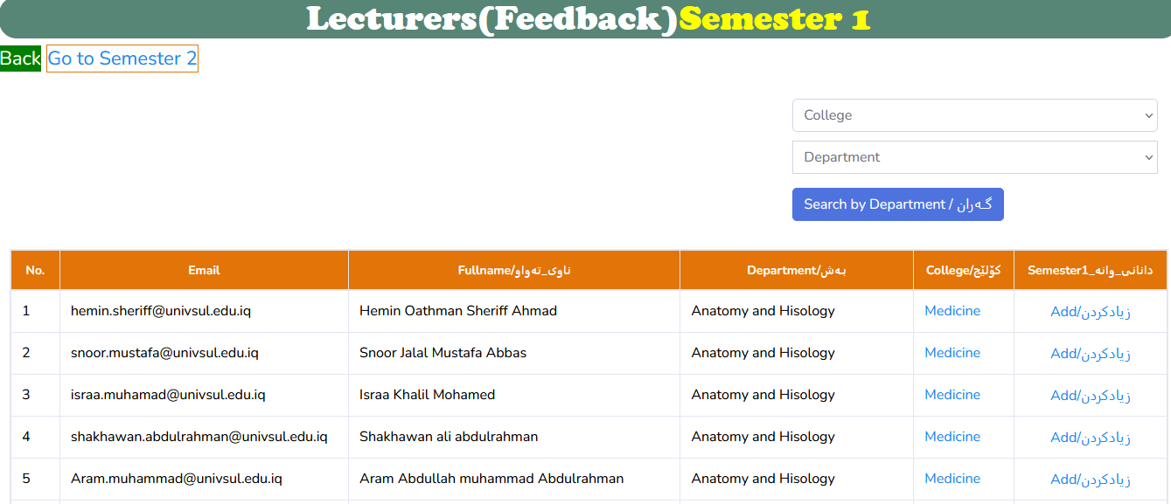

Slide 32
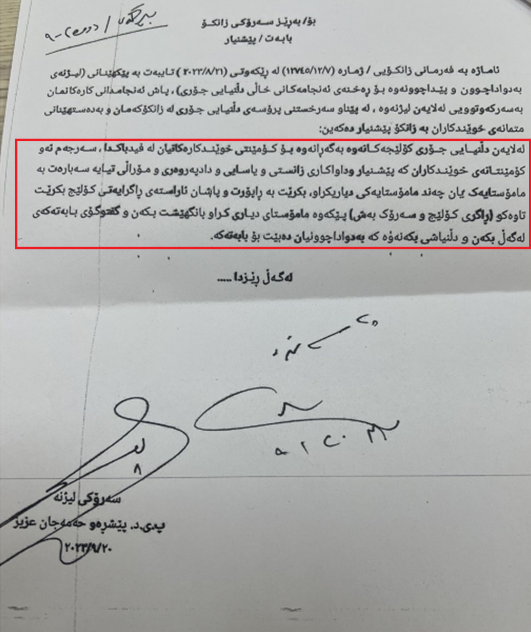

Slide 33
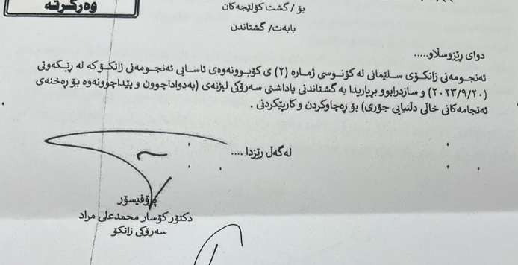

Slide 34
Before the Students Feedback
The students feedback should be used to improve the quality of the educational process.
Confidentiality will be preserved as no names will be shown.
Notes:
TQA recommendation to share the comments and discus them.
New Experience.

Slide 35
Irrelevant Students Feedback Questions
Some of the Criteria of the feedback are irrelevant to the College of Medicine programs (e.g. Quizzes, Seminars, reports, etc..)
پرسیاری (٦،٩،١٠،١١ ) نا دروستن
Notes:
The QA asked to amended these but the ministry is still studying it.

Slide 36
To Do or Not To Do
The students guide should specify what the students are allowed to and what they are not.
Examples include: Using smart devices, recording lectures, eating or drinking, etc…
ئه‌م دكتۆره‌ قبول ناكا له‌ دارسیا ئاو بخورێته‌وه
‌!!! خۆمی ده‌ر كردووه‌ له‌به‌ر ئاو خواردنه‌وه
Notes:
- Phones or Ipads.
Video or audio. pictures
Anything else ?
If there is a manual then there should be a version for the lecturers

Slide 37
Discouraging Students From Contribution
Students participation in groupwork sessions or lectures should be appreciated even if their answer was wrong.
Academic staff should not mock students answer, accent, figure, etc…..
و قوتابییەکیش وەڵامی دایەوە بەڵام شێوازی دەربڕینی زمانی ئینگلیزی زۆر باش نەبوو و ئەم دکتۆرە بە شێوازێکی گاڵتە ئامێزانە پێکەنی وتی ئاکسێنتەکەت زۆر باشە، ، هەموو ئینسانێک کەرامەتی هەیە
Notes:
This would discourage the students to further participate and lose interest in the module or entire process.
Frequently encountered problem. Many lecturers.
- Granting marks for contribution

Slide 38
Slides Number and Time Limit
Consuming the full time of the lectures (e.g. 2 hours) is not recommended by any means.
agar lecture 2h be aw 2 h u 15 daqay pe ache.
278 slide بۆ تەلەبەیەکی مەرحەلە *** مەعقولە؟.
Notes:
Time management is required rather than bringing old lectures from the old system and using them.

Slide 39
Theological Propaganda
There should Never be any kind of promoting religious or political ideas in any lectures.
فکری دینی خۆت تێکەڵی دەرسەکە مەکە، بۆ ئەوەی هەمووی سوودمەند بێت لێت
Notes:
Serious infringements.
It goes both sides of atheism or fundamentalism.

Slide 40
Medical College or Military College?
هەڵسوکەوتی زۆر سەیرە لەگەڵ تەلەبە ئەڵێی کولیەی عەسکەرییە
Notes:
Carrying a Rod and shouting.

Slide 41
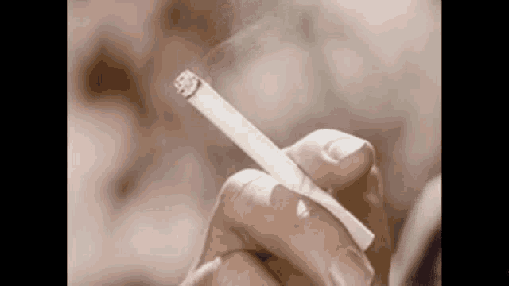
Act of Misconduct
له‌ كاتی موحازه‌ره‌یا جگه‌ره‌ ئه‌كێشێت و حساب بۆ ته‌له‌به‌ ناكا كه‌ پێی ناخۆشه‌
پێویستە جگەرەکێشان لەناو ژووری وانەوتنەوە قەدەغەبێت، ناکرێت دکتۆر لەکاتی وانەوتنەوەدا جگەرە بکێشێت
Notes:
Keep the best for last

Slide 42
Being Desperate
The comments rate has decreased significantly in comparison to previous years which is a sign that students are getting hopeless.
Notes:
We need to raise hope so that we achieve improvements.

Slide 43
Final Message
Lecturers : We use the comments to improve ourselves.
Students : Your voice is heard.
Despite all the shortcomings, all lecturers passed students feedback and the students did not fail anyone.
Some do everything while others do nothing.
Notes:
Not failing anyone is a refection of high consciousness amongst the students.

Slide 44
Thank You

